Slide 1
THE PIC MICROCONTROLLER
1
PIC18F4520: Introduction, Architecture

Slide 2

Embedded System
2
A system whose principal function is
not computational
but which is
controlled by an embedded computer

Slide 3
Microprocessors vs Microcontrollers
3
Microprocessor: processor on one silicon chip.
Microcontroller: microprocessor with added circuitry
Thus microprocessor is a sub-set of microcontroller
Intel Microprocessor vs PIC Microcontroller
Intel is more complex, costs more, is more powerful
PIC is less costly, less complex, far less powerful

Slide 4
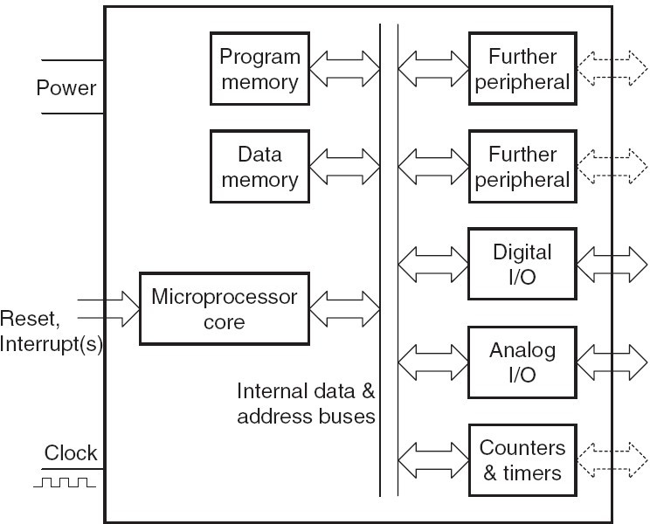
Microcontroller Internals
4

Slide 5
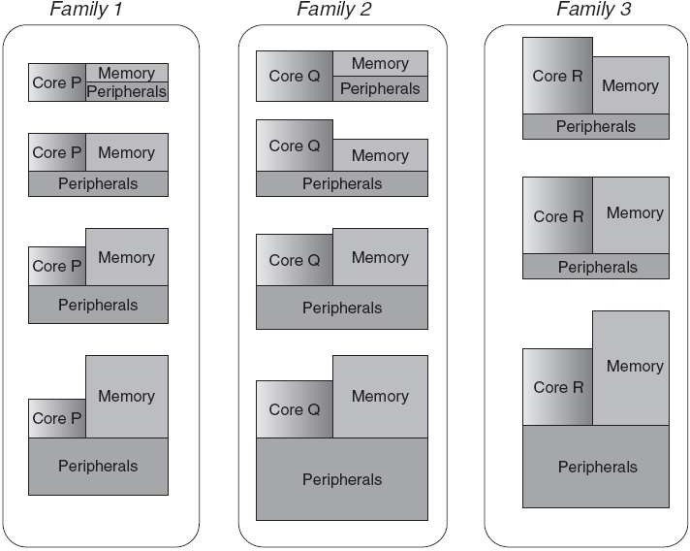
Microcontroller Family – the concept
9

Slide 6
PIC Microcontrollers - history
11
Peripheral Interface Controller (PIC) was originally designed by General Instruments
In the late 1970s, GI introduced PIC1650 and PIC1655 – RISC with 30 instructions
PIC was sold to Microchip
  Microchip today ends up making most of the 8-bit PICs
We are studying the PIC18F family controller
  Features: low-cost, self-contained, 8-bit, Harvard structure, pipelined, RISC, single accumulator, with fixed reset and interrupt vectors

Slide 7
PIC Family: Development history
12
PIC Family | Stack Size | Instruction Word Size | No of Instructions | Interrupt Vectors
12CX/12FX | 2 | 12- or 14-bit | 33 | None
16C5X/16F5X | 2 | 12-bit | 33 | None
16CX/16FX | 8 | 14-bit | 35 | 1
17CX | 16 | 16-bit | 58 | 4
18CX/18FX | 31 | 16-bit | 75 | 2
‘C’ implies CMOS technology; Complementary Metal Oxide Semiconductor
‘F’ insert indicates incorporation of Flash memory technology

Slide 8
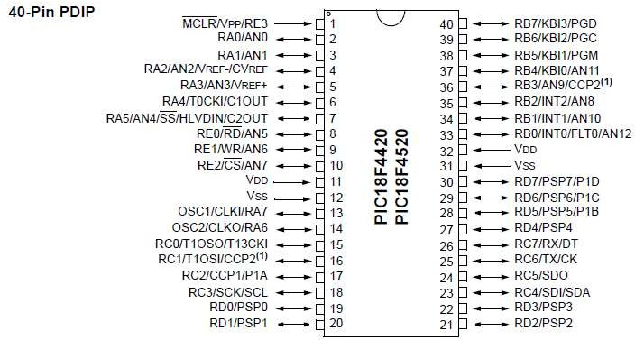
PIC18F4520: Pin-out

Slide 9
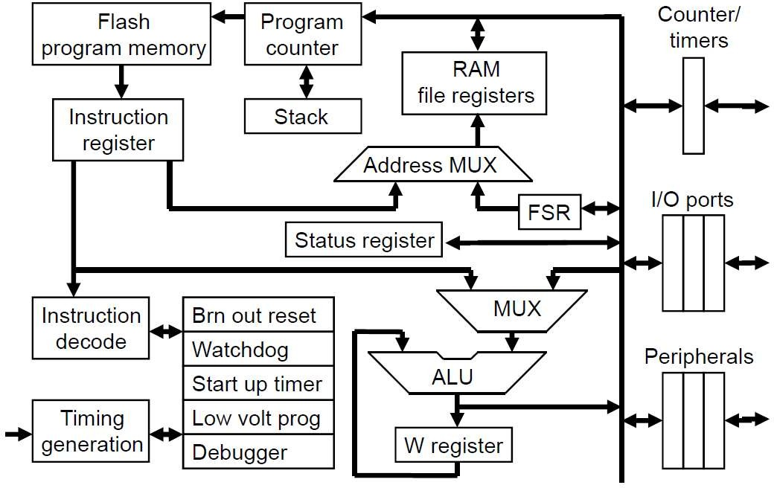
PIC18F: Controller Architecture
15

Slide 10
What are PIC instructions like?
17
Type 1
  Data comes along with the instruction
    Example: ADDLW 0x20
Type 2 – unified address space
  Data comes from file registers
    Internal RAM
      Example: ADDWF 0x20
    External (real-world) peripheral
      Example: ADDWF PORTA
Type 3
  Data comes from “pointer” file-registers (FSRs)
    Example: ADDWF INDF0

Slide 11
PIC18F4520: Peripherals
22
Data Ports (Digital)
  Port A, B, C, D (8-bits each), E (4-bit)
Timer / Counter modules
  Timer0 (8-bit), Timer1 (16-bit), Timer2 (8-bit), Timer3 (16-bit)
CCP/PWM modules
  CCP as well as ECCP
Serial ports
  USART (RS-232)
  I2C, SPI (both buses – Master, Slave modes)
ADC – 10-bit resolution
  13 input channels (with 13-way input multiplexer)
256-byte EEPROM , 32K flash , 1536 bytes SRAM

Slide 12
PIC18F4520: Reset Circuitry
23
Multiple “resets” in hardware:
  Power On Reset
  Hardware Pin (External) Reset – MCLR’ (active low)
  Brown Out Reset – Power Supply Voltage
    BOR tolerance level is configurable in software (5V / 3.3V)
  Watchdog Timer Reset
Startup delays
  Power Up timer (72ms delay)
  Startup Timer (1024 Oscillator cycles)
Software (code) can also perform a reset
Reset makes PIC ‘boot’ from starting location of code (0x00000)

Slide 13
Programming: Stack concept
25
Every CPU has a Program Counter (PC)
  Keeps track of which instruction to execute next
Usually, instructions execute “sequentially”
  One after another – so PC increments
But if there is a function call or interrupt
  Sequential flow is “disturbed”
  For function calls, CPU “jumps” to the location of the function code
    And then has to jump back (after the function “returns”)
    We need to remember the address from where we jumped
      This is stored in the Stack

Slide 14
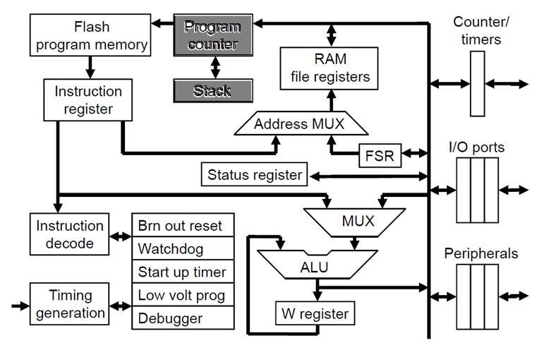
PIC18F: Program flow with stack
26

Slide 15
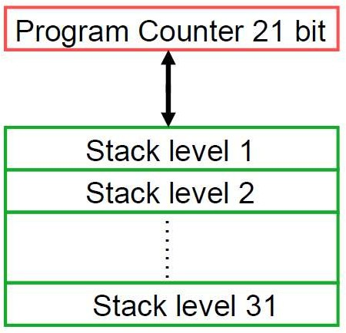

PIC18F: Stack details
27
Stack organization
Stack usage
Function_1()
  Function_2()
    Function_3()
“Nested” functions
Limit to nesting!
  31 levels

Slide 16
PIC18F: Memories
28
Separate Memory Regions:
  Code / Program – Non-volatile memory (NAND Flash)
    Holds program / instructions
  Data – Volatile memory (RAM)
    Holds run-time data
Address Spaces are different
  Though the range “overlaps”
eg. 0x10 could be a code address as well as a data address!
We need to be specific about which memory are we talking about!

Slide 17
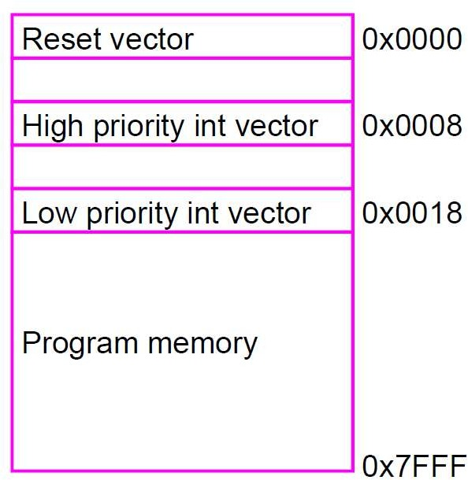
PIC18F: Code memory map
29
Non-volatile
Range:
  0x0000 to 0x7FFF (32k)
Each location contains 1 instruction
3 special addresses:
  0x0000
  0x0008
  0x0018

Slide 18
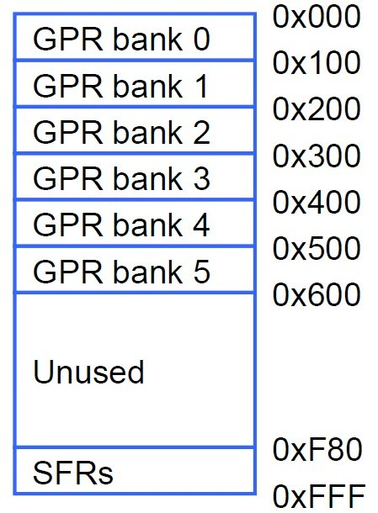
PIC18F: Data memory map
30
8 bits
Volatile memory
0x000
0x001
Range:
  0x000 to 0xFFF
Each location is 8-bits
  Also called FREG
  Has an address eg. 0x020
Bank: 256-byte chunk
  Top bank: GPR0
  Bottom bank: SFR
Only SFR and any 1 GPR
active at a time

Slide 19
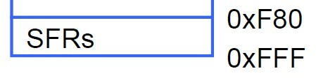
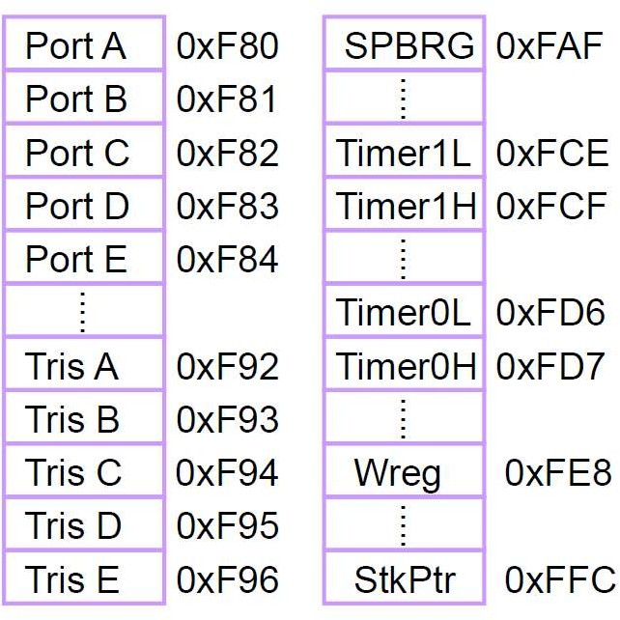
PIC18F: SFR data bank
32
Special Function Register
(SFR) bank
Each location is 8-bits
  Also called FREG
  Has address as well as “label”/”name”
eg. PORTA, WREG
They fulfill important functions
  WREG
  Peripherals (IO Ports)
  Counters/Timers
Always active data bank

